Slide 1
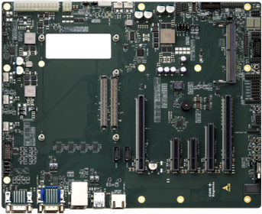
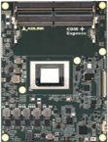
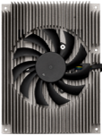
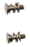
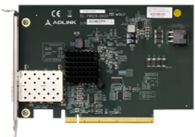
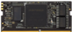
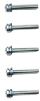
Use this one

Slide 2
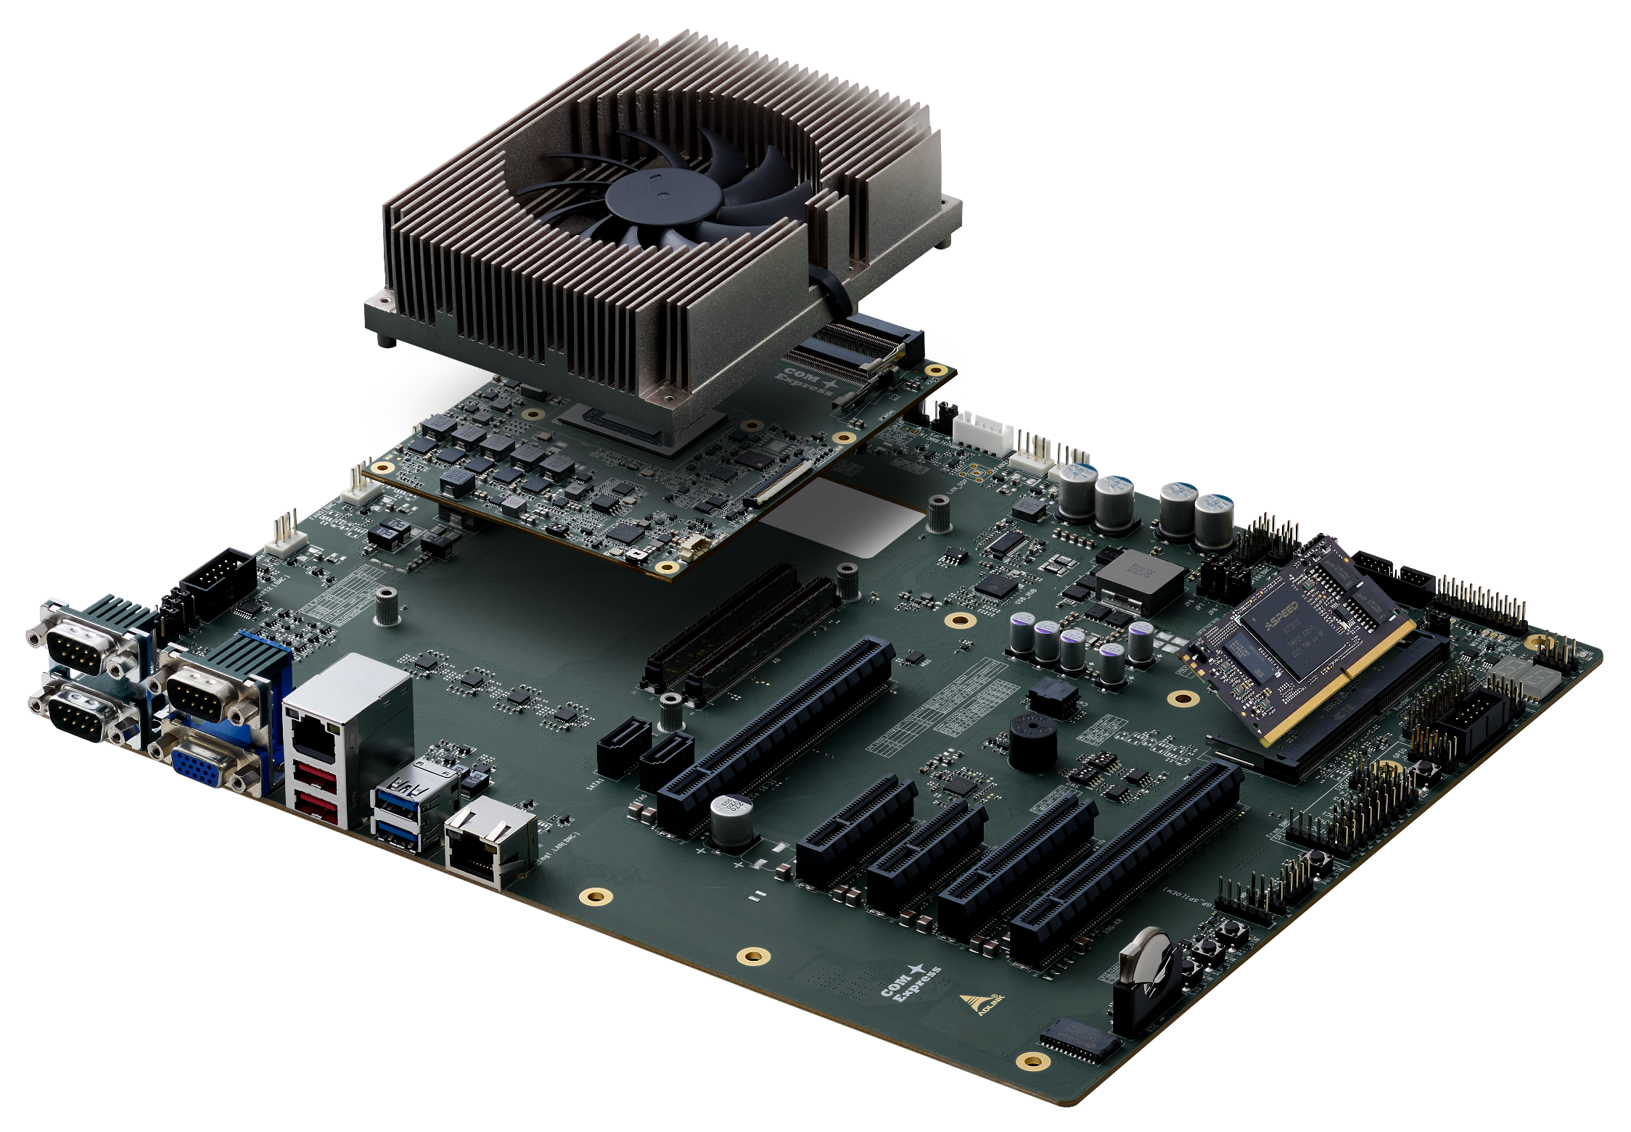
Use this one
Step 1
Assemble DDR5 memory into COM Express Module
Removed all protective membranes from the thermal pads
Assemble Heatsink with COM Express Module with 2pcs screws, bottom mounting
Step 2
Place the COM Express Module/Heatsink assembly onto the connectors on the COM Express Carrier
Assemble them with 5pcs screws, bottom mounting
Step 3
Assemble BMC Module onto DDR4 SO-DIMM socket located on COM Express Carrier

Slide 3
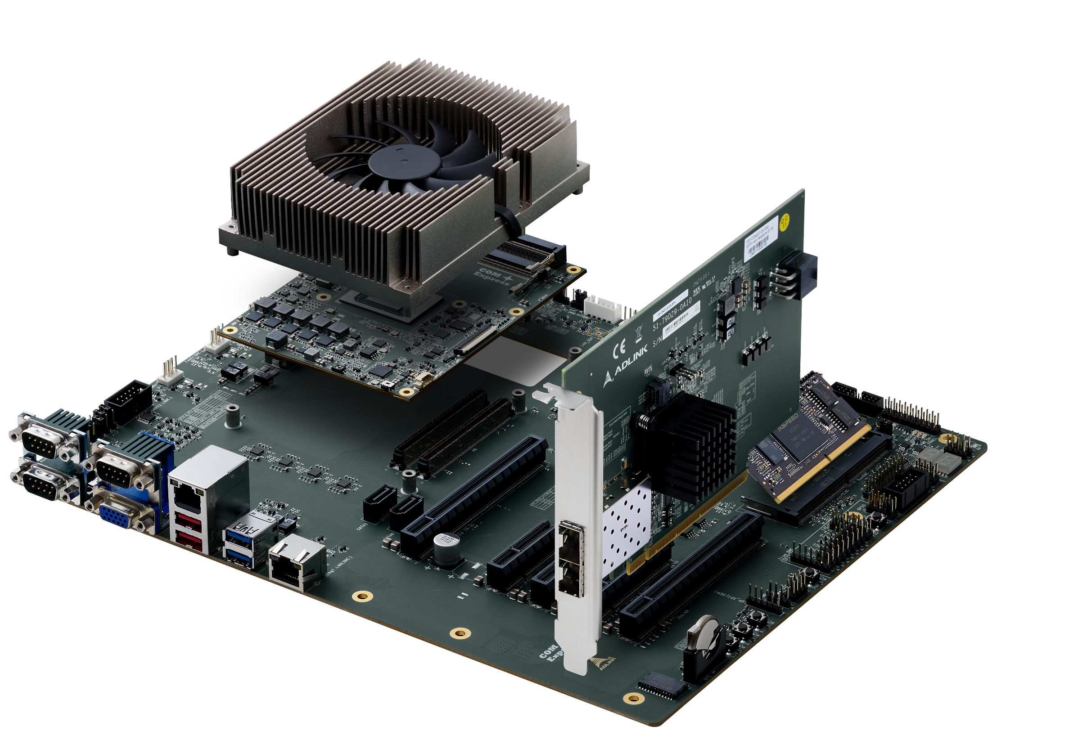
Use this one
Assemble the 10G Ethernet Card onto the x16 slot. The slot is named as 10G-KR

Slide 4
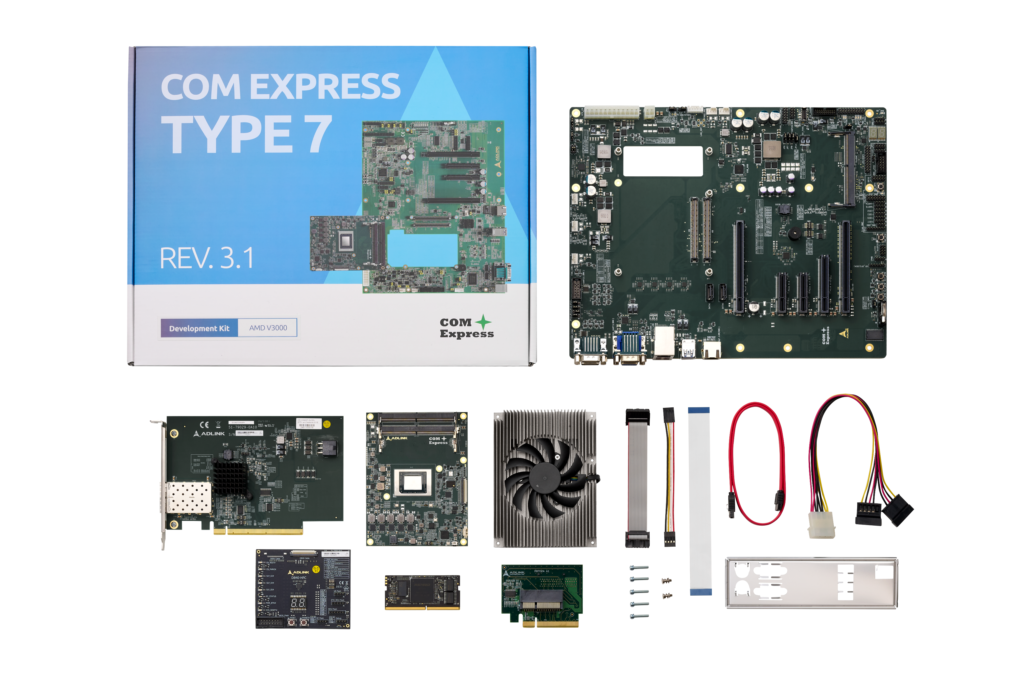

Slide 6
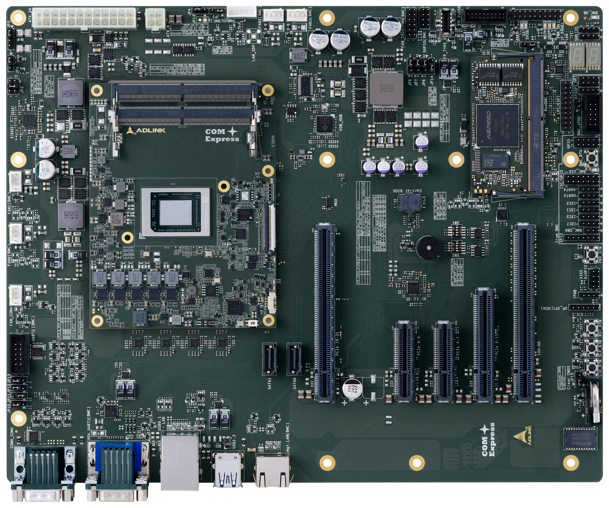
IPMI Interfaces
Use this one
FAN3
FAN2
FAN_TACH/PWM
BMC_LED
GPI
GPIO
FAN1
I2C/GPIO
UART3, UART4
I2C1, 2, 5, 7
FAN0
BMC_DBG
IPMB
UART2
UART1
VGA
USB2
(bottom)
mgt.
LAN

